Slide 1
Lending CLUB CASE STUDY
Karthik Subramanian

Slide 2
Problem Statement
Lending Club is a marketplace for personal loans that matches borrowers who are seeking a loan with investors looking to lend money and make a return.
The company wants to understand the driving factors (or driver variables) behind loan default, i.e. the variables which are strong indicators of default. The company can utilize this knowledge for its portfolio and risk assessment.

Slide 3
SOLUTION
UNDERSTANDING DATA
DATA CLEANING
Check the data visually to understand how is the data format and check if there is an obvious issues with csv files provided
In this step we will check if there are any missing values, redundant column etc. We will convert the csv data into a usable format before analyzing any further
DATA ANALYSIS
RECOMMENDATIONS
This is the key step where data is comprehensively analyzed using Univariate, Segmented Univariate, Bivariate analysis is done
Based on the data analysis, a complete list of observations are recorded and submitted to the investors.

Slide 4
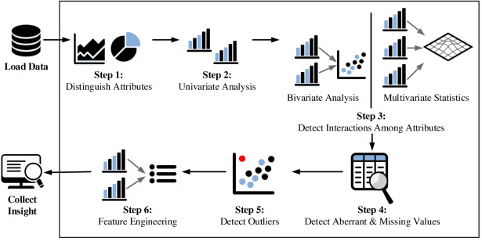
Analysis of loan data

Slide 5
Observations
Default occurs mostly when
Applicants having house_ownership as 'RENT'
Applicants who use the loan to clear other debts
Applicants who receive interest at the rate of 13-17%
Applicants who have an income of range 31201 - 58402
Term of 36 months
When the loan status is Not verified
When the no of enquiries in last 6 months is 0
When the number of derogatory public records is 0
When the purpose is 'debt_consolidation'
Grade is 'B'
And a total grade of 'B5' level.

Slide 6
Observations…
Default occurs mostly when
Applicants taking loan for 'home improvement' and have income of 60k -70k
Applicants whose home ownership is 'MORTGAGE and have income of 60-70k
Applicants who receive interest at the rate of 21-24% and have an income of 70k-80k
Applicants who have taken a loan in the range 30k - 35k and are charged interest rate of 15-17.5 %
Applicants who have taken a loan for small business and the loan amount is greater than 14k
Applicants whose home ownership is 'MORTGAGE and have loan of 14-16k
When grade is F and loan amount is between 15k-20k
When employment length is 10yrs and loan amount is 12k-14k
When the loan is verified and loan amount is above 16k
For grade G and interest rate above 20%

